Slide 1
Object-Oriented Systems Development:
Using the Unified Modeling Language
Chapter 9:
The Object-Oriented Design Process and Design Axioms
Object-Oriented Systems Development Bahrami © Irwin/ McGraw-Hill

Slide 2

Goals
The object-oriented design process.
Object-oriented design axioms and corollaries.
Design patterns.
Object-Oriented Systems Development Bahrami © Irwin/ McGraw-Hill

Slide 3
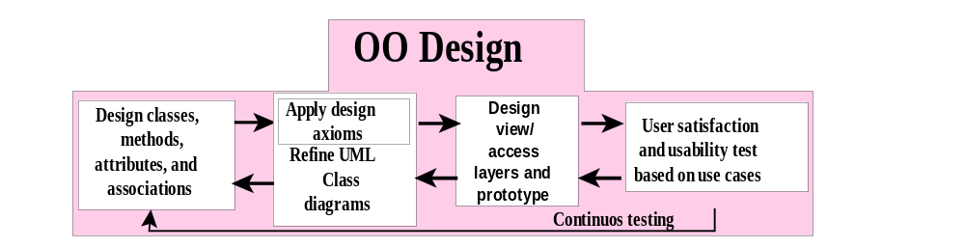
Object-Oriented Design Process in the Unified Approach
Object-Oriented Systems Development Bahrami © Irwin/ McGraw-Hill
Notes:
During the design phase, we must elevate the model into actual objects that can perform the required task. There is a shift in emphasis from the application domain to implementation. The classes identified during analysis provide us a framework for the design phase. In this part, we discuss business, view, and access layers classes.

Slide 4
OO Design Process
1. Apply design axioms to design classes, their attributes, methods, associations, structures, and protocols.
    1.1. Refine and complete the static UML class diagram (object model) by adding details to the UML class diagram. This step consists of the following activities:
    1.1.1. Refine attributes.
      1.1.2. Design methods and protocols by utilizing a UML activity diagram to represent the method's algorithm.
      1.1.3. Refine associations between classes (if required).
      1.1.4. Refine class hierarchy and design with inheritance (if required).
    1.2. Iterate and refine again.
Object-Oriented Systems Development Bahrami © Irwin/ McGraw-Hill

Slide 5
OO Design Process (Con’t)
2. Design the access layer
2.1. Create mirror classes. For every business class identified and created, create one access class.
  2.2. define relationships among access layer classes.
  2.3. Simplify the class relationships. The main goal here is to eliminate redundant classes and structures.
    2.3.1. Redundant classes: Do not keep two classes that perform similar translate request and translate results activities. Simply select one and eliminate the other.
    2.3.2. Method classes: Revisit the classes that consist of only one or two methods to see if they can be eliminated or combined with existing classes.
  2.4. Iterate and refine again.
Object-Oriented Systems Development Bahrami © Irwin/ McGraw-Hill

Slide 6
OO Design Process (Con’t)
3. Design the view layer classes.
  3.1. Design the macro level user interface, identifying view layer objects.
  3.2. Design the micro level user interface, which includes these activities:
    3.2.1. Design the view layer objects by applying the design axioms and corollaries.
    3.2.2. Build a prototype of the view layer interface.
  3.3. Test usability and user satisfaction (Chapters 13 and 14).
  3.4. Iterate and refine.
4. Iterate and refine the preceding steps. Reapply the design axioms and, if needed, repeat the preceding steps.
Object-Oriented Systems Development Bahrami © Irwin/ McGraw-Hill

Slide 7

Object-Oriented Design
Axioms, Theorems and Corollaries
An axiom is a fundamental truth that always is observed to be valid and for which there is no counterexample or exception.
A theorem is a proposition that may not be self-evident but can be proven from accepted axioms.
Object-Oriented Systems Development Bahrami © Irwin/ McGraw-Hill

Slide 8

Axioms, Theorems and Corollaries (Con’t)
A Corollary is a proposition that follows from an axiom or another proposition that has been proven.
Object-Oriented Systems Development Bahrami © Irwin/ McGraw-Hill

Slide 9
Design Axioms
Axiom 1 deals with relationships between system components (such as classes, requirements, software components).
Axiom 2 deals with the complexity of design.
Object-Oriented Systems Development Bahrami © Irwin/ McGraw-Hill

Slide 10
Axioms
Axiom 1. The independence axiom. Maintain the independence of components.
Axiom 2. The information axiom. Minimize the information content of the design.
Object-Oriented Systems Development Bahrami © Irwin/ McGraw-Hill
Notes:
Axiom 1 states that, during the design process, as we go from a use case to requirement to a system component, each component must satisfy that requirement without affecting other requirements.
Axiom 2 is concerned with simplicity. Scientific theoreticians often rely on a general rule known as Occam's razor, after William of Occam, a 14th century scholastic philosopher.

Slide 11

Occam's Razor
The best theory explains the known facts with a minimum amount of complexity and maximum simplicity and straightforwardness.
Object-Oriented Systems Development Bahrami © Irwin/ McGraw-Hill

Slide 12
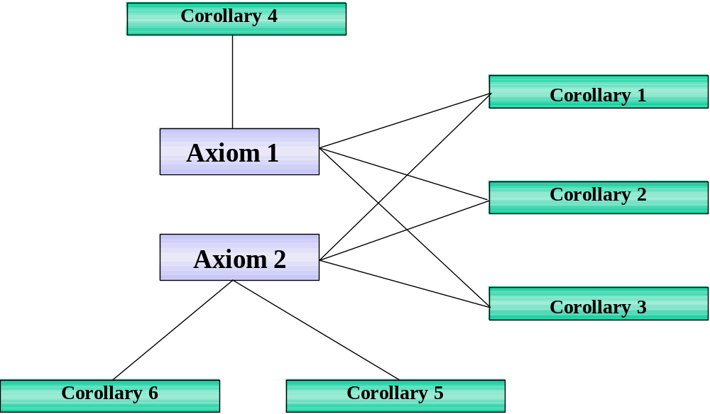
The Origin of Corollaries
Object-Oriented Systems Development Bahrami © Irwin/ McGraw-Hill
Notes:
Corollaries 1, 2 and 3 from both axioms, whereas corollary 4 from axiom 1 and corollaries 5, and 6 form axiom 2.

Slide 13
Corollaries
Corollary 1. Uncoupled design with less information content.
Corollary 2. Single purpose. Each class must have single, clearly defined purpose.
Corollary 3. Large number of simple classes. Keeping the classes simple allows reusability.
Object-Oriented Systems Development Bahrami © Irwin/ McGraw-Hill

Slide 14
Corollaries (Con’t)
Corollary 4. Strong mapping. There must be a strong association between the analysis's object and design's object.
Corollary 5. Standardization. Promote standardization by designing interchangeable components and reusing existing classes or components.
Object-Oriented Systems Development Bahrami © Irwin/ McGraw-Hill

Slide 15
Corollaries (Con’t)
Corollary 6. Design with inheritance. Common behavior (methods) must be moved to superclasses.
The superclass-subclass structure must make logical sense.
Object-Oriented Systems Development Bahrami © Irwin/ McGraw-Hill

Slide 16
Coupling and Cohesion
Coupling is a measure of the strength of association among objects.
Cohesion is interactions within a single object or software component.
Object-Oriented Systems Development Bahrami © Irwin/ McGraw-Hill

Slide 17
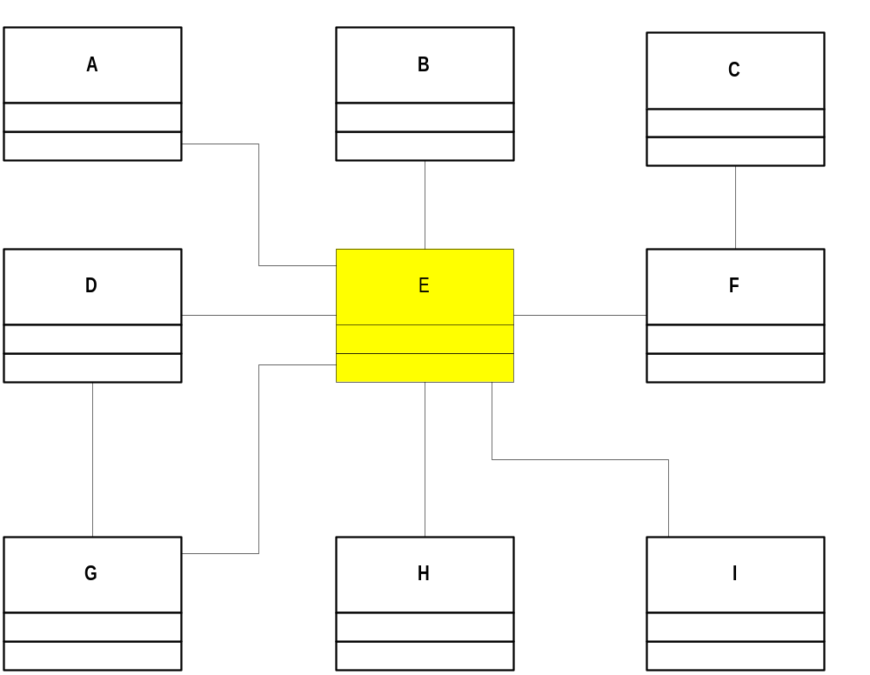
Tightly Coupled Object
Object-Oriented Systems Development Bahrami © Irwin/ McGraw-Hill

Slide 18
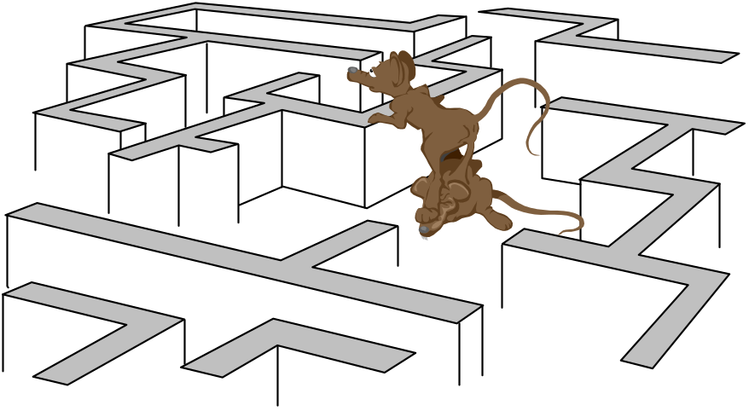
Corollary 1- Uncoupled Design with Less Information Content
The main goal here is to maximize objects (or software components) cohesiveness.
Object-Oriented Systems Development Bahrami © Irwin/ McGraw-Hill

Slide 19

Corollary 2 - Single Purpose
Each class must have a purpose, as was explained in a previous chapter.
When you document a class, you should be able to easily explain its purpose in a sentence or two.
Object-Oriented Systems Development Bahrami © Irwin/ McGraw-Hill

Slide 20

Corollary 3- Large Number of Simpler Classes, Reusability
A great benefit results from having a large number of simpler classes.
The less specialized the classes are, the more likely they will be reused.
Object-Oriented Systems Development Bahrami © Irwin/ McGraw-Hill

Slide 21
Corollary 4. Strong Mapping
As the model progresses from analysis to implementation, more detail is added, but it remains essentially the same.
A strong mapping links classes identified during analysis and classes designed during the design phase.
Object-Oriented Systems Development Bahrami © Irwin/ McGraw-Hill

Slide 22
Corollary 5. Standardization
The concept of design patterns might provide a way for standardization by capturing the design knowledge, documenting it, and storing it in a repository that can be shared and reused in different applications.
Object-Oriented Systems Development Bahrami © Irwin/ McGraw-Hill

Slide 23


Corollary 6. Designing with Inheritance
Say we are developing an application for the government that manages the licensing procedure for a variety of regulated entities.
Let us focus on just two types of entities: motor vehicles and restaurants.
Object-Oriented Systems Development Bahrami © Irwin/ McGraw-Hill

Slide 24
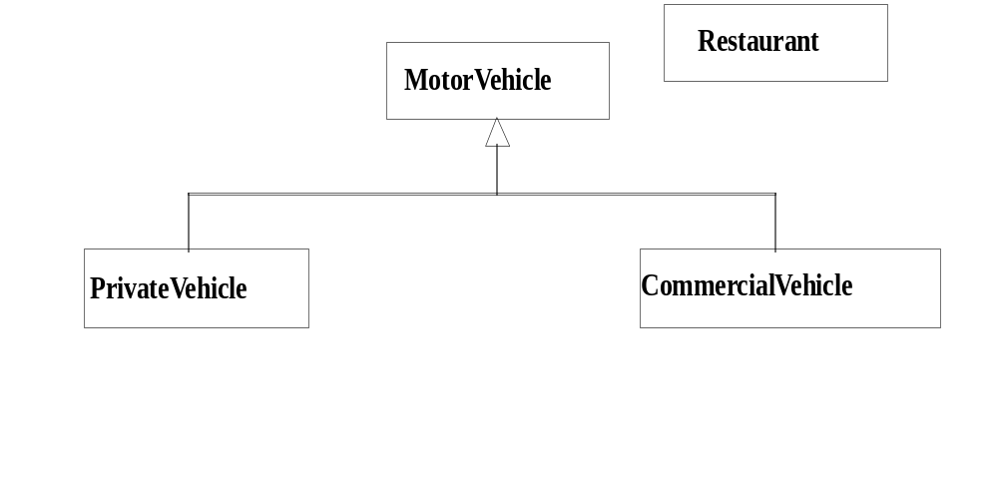
Designing With Inheritance (Con’t)
Object-Oriented Systems Development Bahrami © Irwin/ McGraw-Hill
Notes:
The initial single inheritance design.

Slide 25
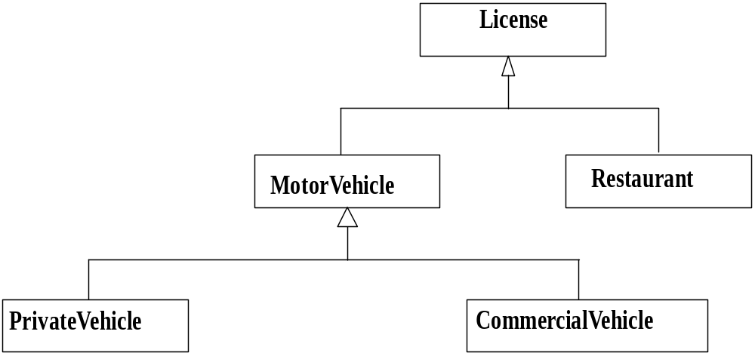
Designing With Inheritance (Con’t)
Object-Oriented Systems Development Bahrami © Irwin/ McGraw-Hill
Notes:
The single inheritance design has been modified to allow licensing of food trucks.

Slide 26

Six Months Later
"What about coffee wagons, food trucks, and ice cream vendors? We're planning on licensing them as both restaurants and motor vehicles."
Object-Oriented Systems Development Bahrami © Irwin/ McGraw-Hill

Slide 27
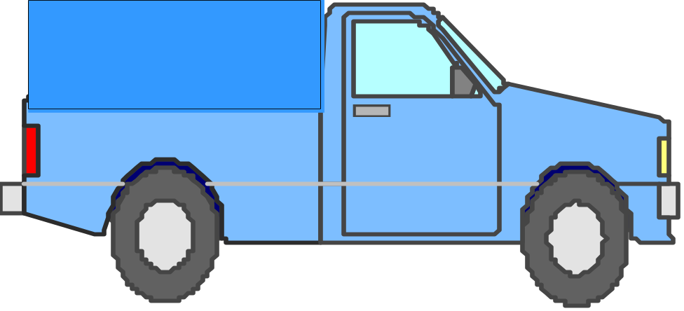

Designing With Inheritance
Weak Formal Class
MotorVehicle and Restaurant classes do not have much in common.
For example, of what use is the gross weight of a diner or the address of a truck?
Object-Oriented Systems Development Bahrami © Irwin/ McGraw-Hill

Slide 28
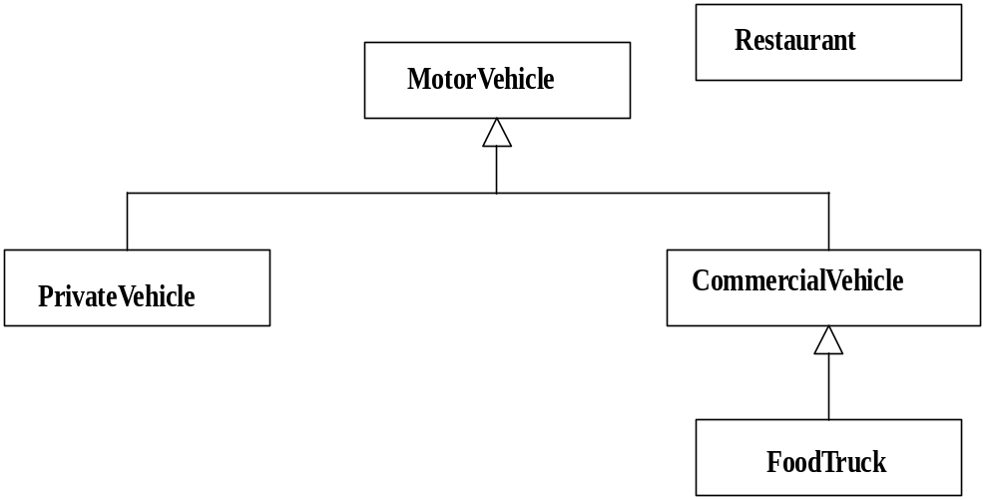
Designing With Inheritance (Con’t)
Object-Oriented Systems Development Bahrami © Irwin/ McGraw-Hill
Notes:
Alternatively, you can modified the single inheritance design to allow for licensing of food trucks.

Slide 29
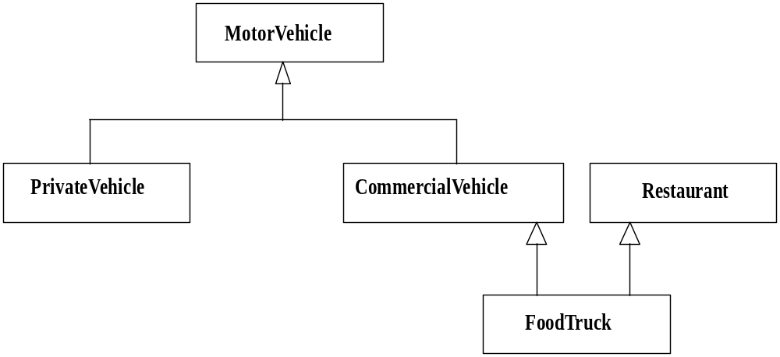
Designing With Inheritance (Con’t)
Object-Oriented Systems Development Bahrami © Irwin/ McGraw-Hill
Notes:
Multiple inheritance design of the system structure.

Slide 30
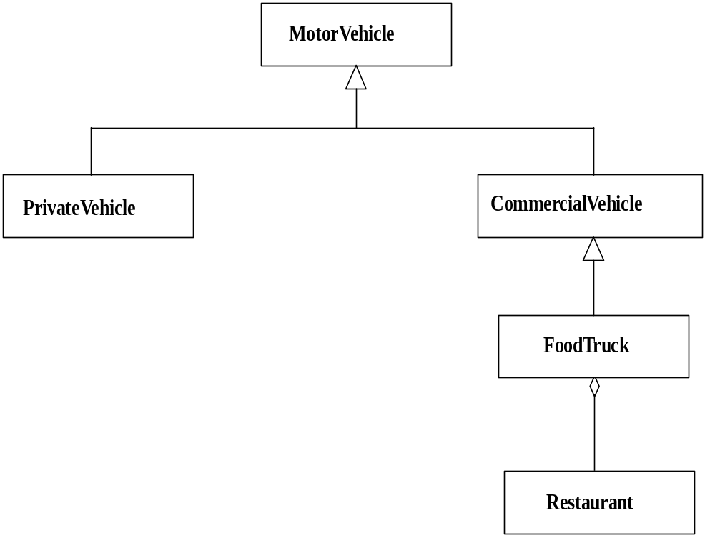
Achieving Multiple Inheritance using Single Inheritance Approach
Object-Oriented Systems Development Bahrami © Irwin/ McGraw-Hill
Notes:
The FoodTruck class inherits from CommercialVehicle and has an attribute of type Restaurant. The relationship between FoodTruck and Restaurant is a-part-of.

Slide 31
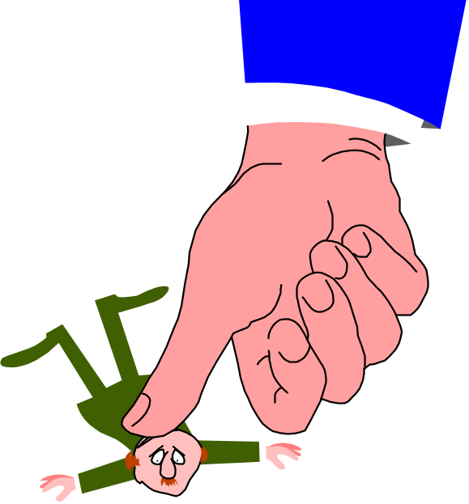
Avoid Inheriting Inappropriate Behaviors
You should ask the following questions:
I. Is the subclass fundamentally similar to its superclass? or,
II. Is it entirely a new thing that simply wants to borrow some expertise from its superclass?
Object-Oriented Systems Development Bahrami © Irwin/ McGraw-Hill

Slide 32
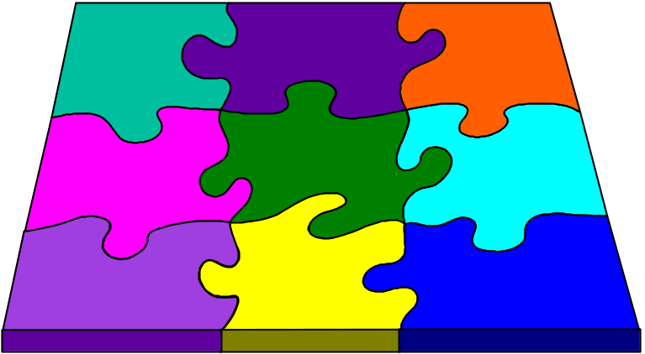
Design Patterns
Patterns provide a mechanism for capturing and describing commonly recurring design ideas that solve a general design problem.
Object-Oriented Systems Development Bahrami © Irwin/ McGraw-Hill

Slide 33
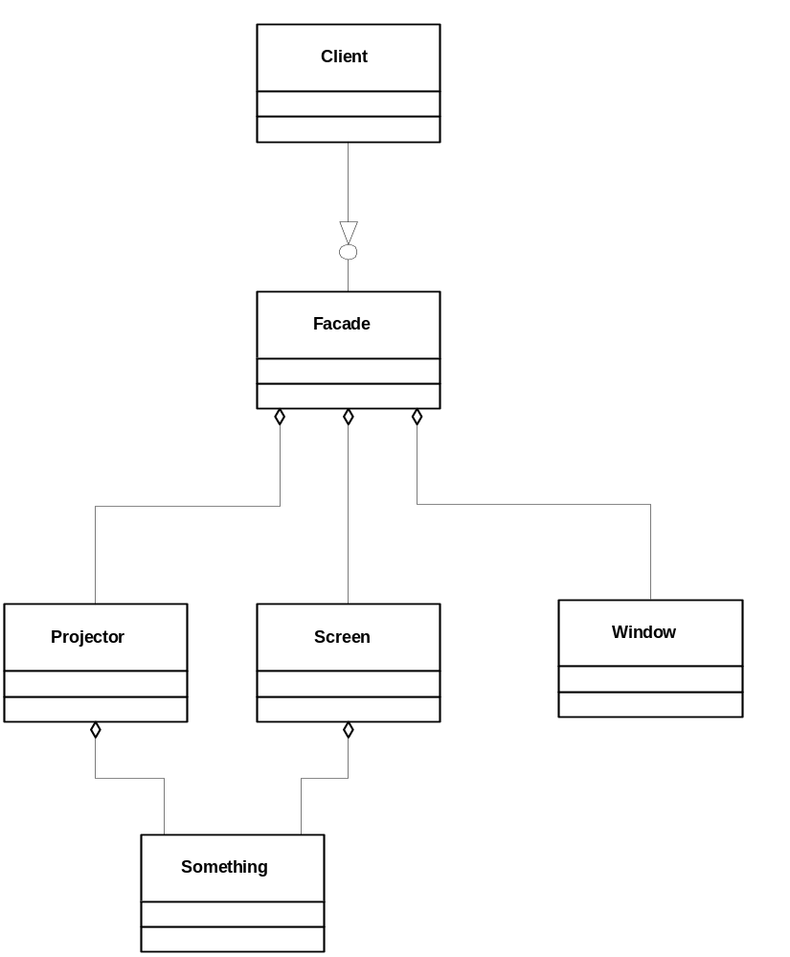
Design Patterns (Con’t)
Object-Oriented Systems Development Bahrami © Irwin/ McGraw-Hill
Notes:
Using design pattern facade, eliminates the need for the client class to deal with a large number of classes.

Slide 34
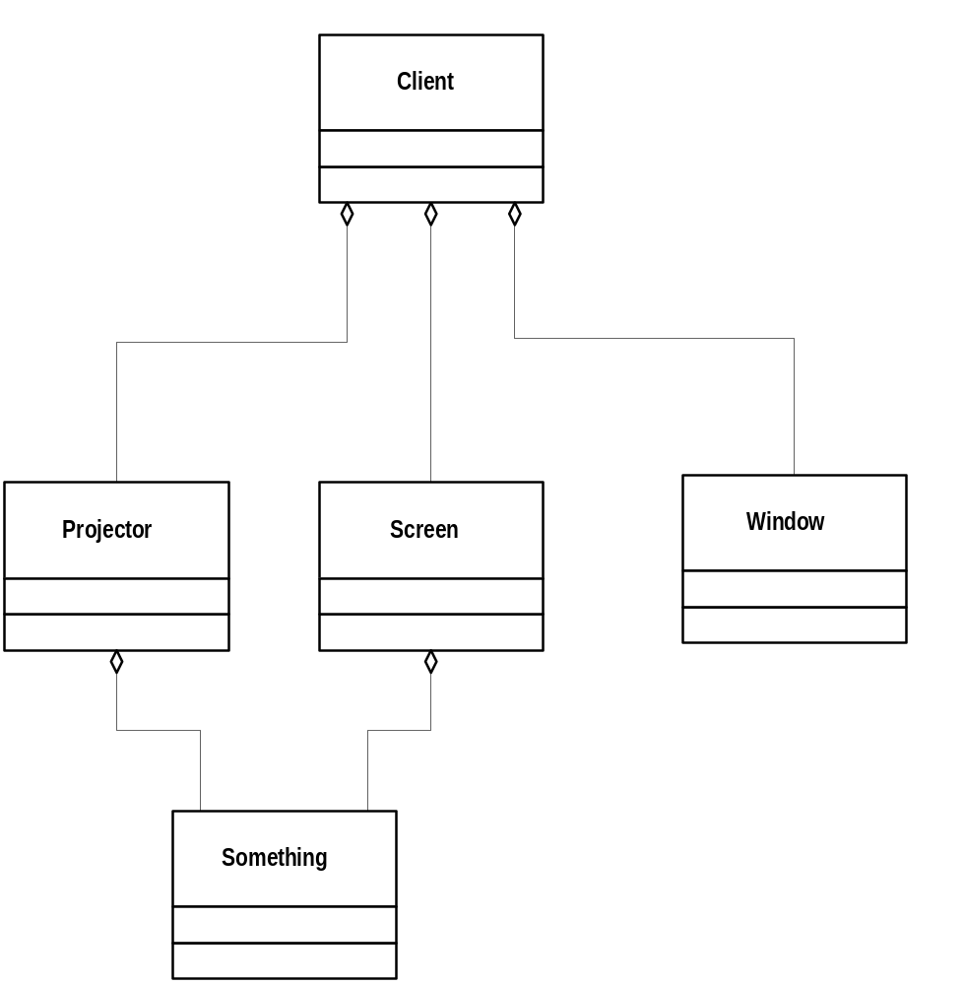
Design Patterns (Con’t)
Object-Oriented Systems Development Bahrami © Irwin/ McGraw-Hill
Notes:
Not utilizing the design pattern facade, the client class needs to deal with a large number of classes.

Slide 35

Summary
We studied the object-oriented design process and axioms.
The two design axioms are
  Axiom 1. The independence axiom. Maintain the independence of components.
  Axiom 2. The information axiom. Minimize the information content of the design.
Object-Oriented Systems Development Bahrami © Irwin/ McGraw-Hill

Slide 36
Summary (Con’t)
The six design corollaries are
  Corollary 1. Uncoupled design with less information content.
  Corollary 2. Single purpose.
  Corollary 3. Large number of simple classes.
  Corollary 4. Strong mapping.
  Corollary 5. Standardization.
  Corollary 6. Design with inheritance.
Object-Oriented Systems Development Bahrami © Irwin/ McGraw-Hill

Slide 37
Summary (Con’t)
We also studied the concept of design patterns, which allow systems to share knowledge about their design.
Object-Oriented Systems Development Bahrami © Irwin/ McGraw-Hill

